Slide 1
MAINTENANCE
BUSINESS FUNCTIONAL AREA

Slide 2
MAINTENANCE MANAGEMENT
MAINTENANCE OBJECTIVE AND STRATEGY
RELIABILITY CENTRED MAINTENANCE
DIGITAL MAINTENANCE
MEASURING MAINTENCE PERFORMANCE
MAINTENANCE SOFTWARE
REFERENCES

Slide 3
MAINTENANCE MANAGEMENT

Slide 4
WHAT IS MAINTENANCE MANAGEMENT
Maintenance are those activities that protect the original or operational condition of equipment or facilities
Asset management considers the entire lifecycle (service life) of the asset and the associated costs, from the identification of a need through to the final decommissioning of the asset.
Asset service life information informs strategic planning, financial planning and control, service delivery, operations and maintenance.
Predictive maintenance, known as condition-based maintenance, aims to detect incipient failures and eventual degradation based on detection of trends of component conditions using historical data so that early actions can be taken

Slide 5
MAINTENANCE OBJECTIVES AND STRATEGY

Slide 6
MAINTENANCE OBJECTIVES
To maximize production uptime by eliminating unplanned, reactive maintenance.
Attain competitiveness through equipment utilization and people involvement.
Extending equipment lifetime by replacement, repair, the mean time to the next failure whose may be too costly;
Reducing the frequency of service interruptions and the many undesirable consequences of such interruptions;
Improving component and system reliability;
Enhancing equipment capability quantitatively and qualitatively;
Improving safety, health and environmental factors in the expectation that such improvements will contribute to better quality and higher profits
Reducing maintenance costs by increasing system capacity, reinforcing redundancy and employing more reliable components.

Slide 7
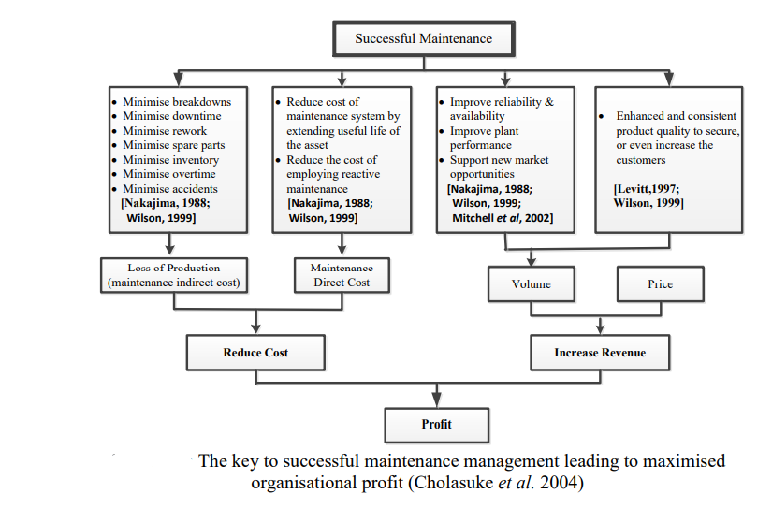

Slide 8
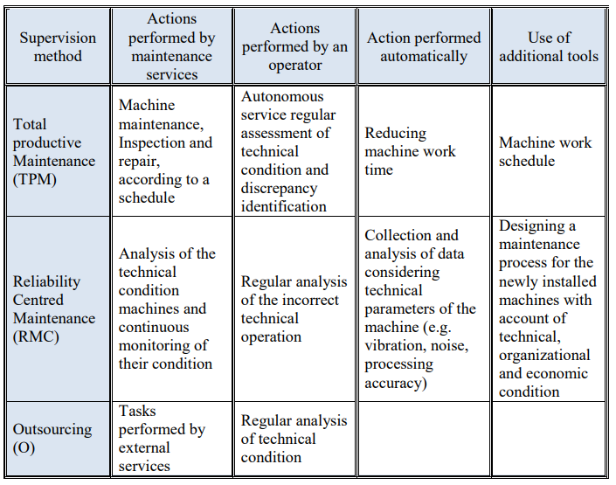
MAINTENANCE STRATEGY

Slide 9
RELIABILITY CENTRED MAINTENANCE

Slide 10
RCM STRATEGIES
Strategies to minimize system failures and ultimately increase equipment reliability and availability.
The most critical assets are those that are likely to fail often or have large consequences of failure.
Implementing RCM increases equipment availability, and reduces maintenance and resource costs.

Slide 11
CREATE A RCM STRATEGY
Selection of equipment for RCM analysis
Define the boundaries and function of the systems that contain the selected equipment
Define the ways in which the system can fail (failure modes)
Identify the root causes of the failure modes
Assess the effects of failure
Select a maintenance tactic for each failure mode
Implement and then regularly review the maintenance tactic selected

Slide 12
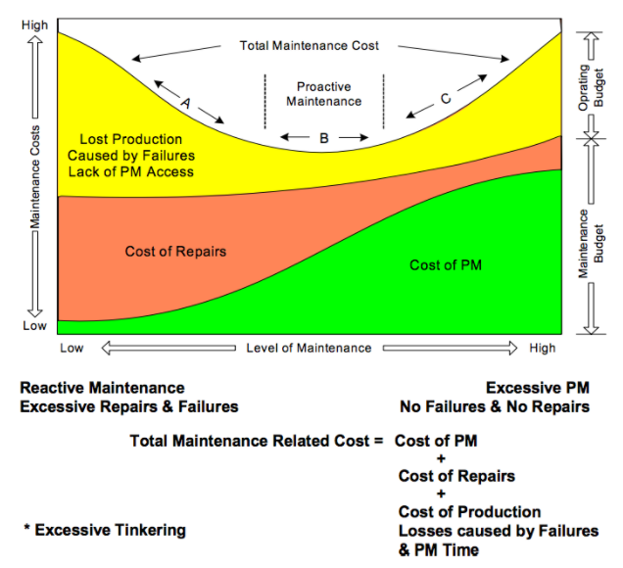
ACTIVITY
GROUP DISCUSSION
In your group, review the graph
Do you think maintenance is important?

Slide 13
DIGITAL MAINTENANCE

Slide 14
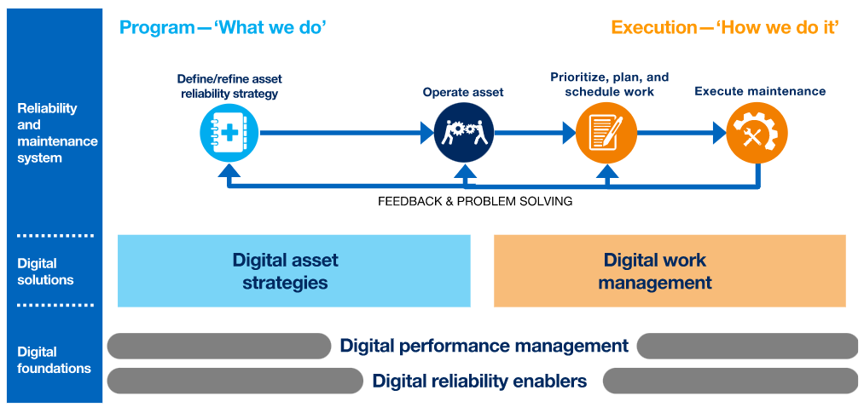
DIGITAL ASSET STRATEGIES

Slide 15
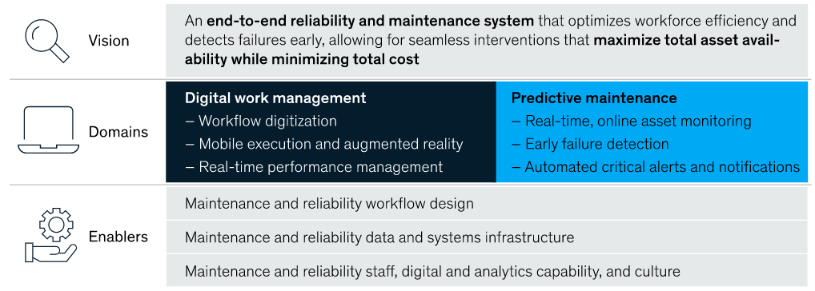
END TO END RELIABILITY

Slide 16
MEASURING MAINTENANACE PERFORMANCE

Slide 17
KEY MAINTENANCE PARAMETERS
Consequence of Failure Analysis (COFA) – The methodology used to determine the result of component failure which leads to the component classification as either critical, potentially critical, commitment, economic or run-to-failure.
Emergency Work - a maintenance task that must be completed within 24 hrs to avert an immediate safety hazard, an environmental hazard, or to correct a failure with significant economic impact.
Mean Time Between Failures (MTBF) - a measure of equipment reliability, calculated by dividing the time period an asset has been in service by the number of failures that have occurred during this time period or by taking the arithmetic average of the individual times between failures.
Mean Time To Repair (MTTR) - a measure of maintainability. MTTR is the average time to repair an asset. It is pure repair time and is also known as wrench time.
Overall Equipment Effectiveness (OEE) – a measure used to rate the effectiveness of an asset, calculated by multiplying availability by performance rate by quality rate.
Periodicity – the time interval or number of cycles between repeated maintenance tasks.

Slide 18
ACTIVITY
GROUP ACTIVITY
In your group, discuss how each of these six processes affects a business
Inventory Management
Preventative Maintenance
Scheduling
Service History
Technician Management
Work Order Management

Slide 19
MAINTENANCE SOFTWARE

Slide 20
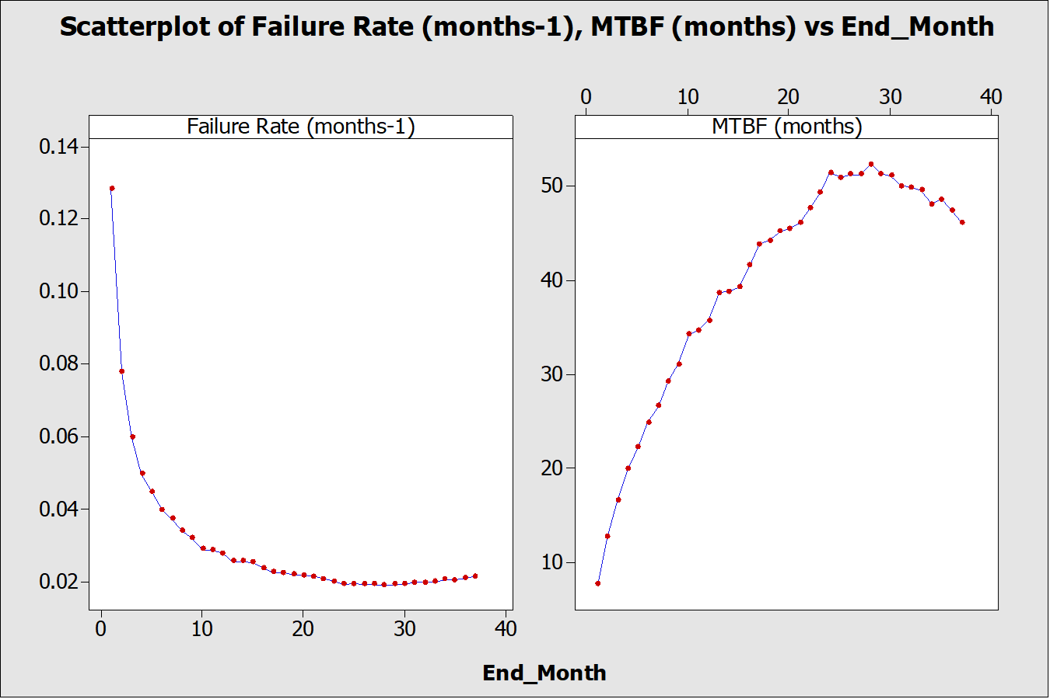
SOFTWARE OUTPUT

Slide 21
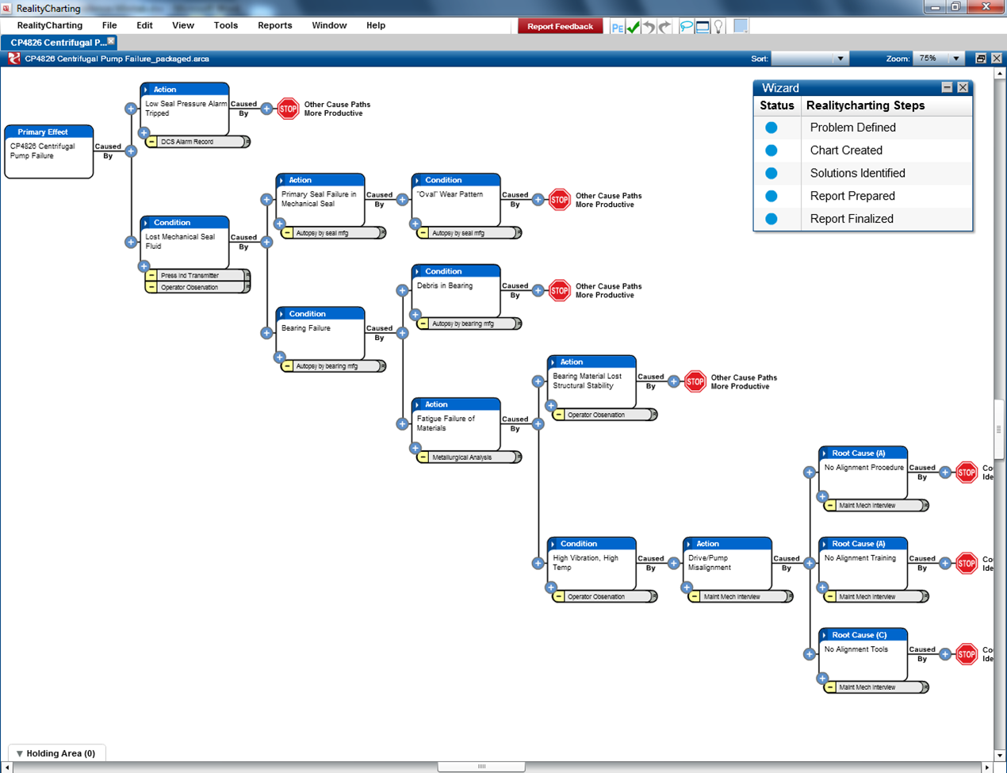
SOFTWARE OUTPUT

Slide 22
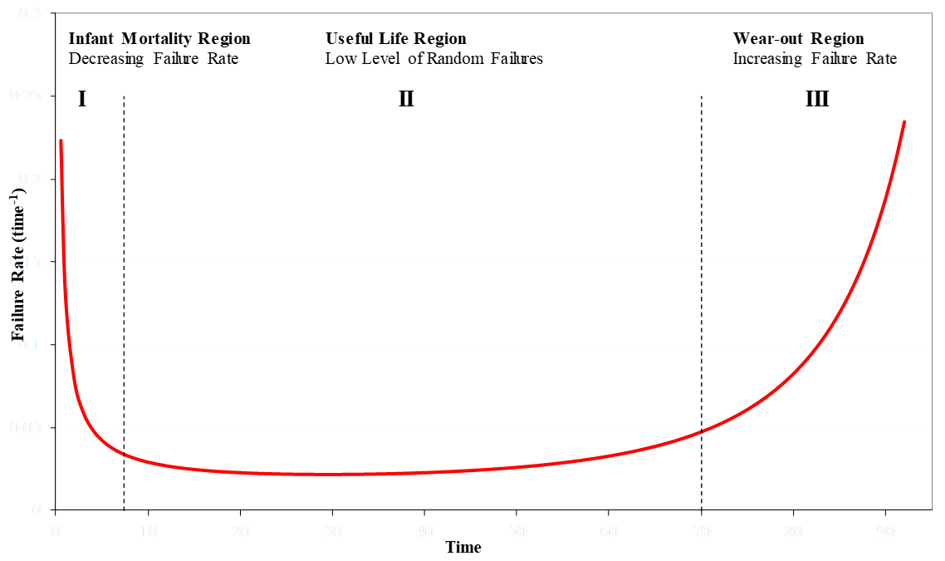
ACTIVITY
GROUP DISCUSSION
In your group, discuss buying a new machine and what to expect in terms of the graph below.

Slide 23
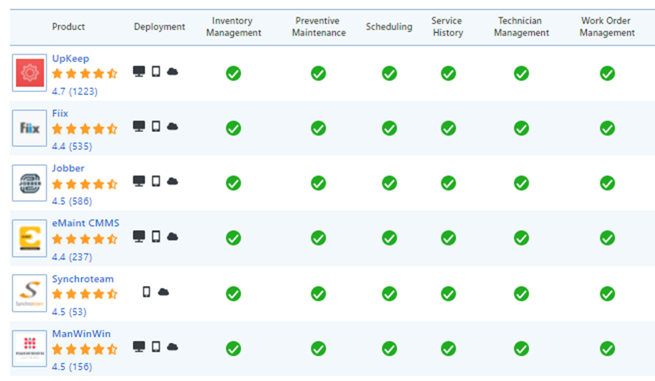
ACTIVITY
GROUP ACTIVITY
Select one of the Maintenance Software packages on the list and identify the maintenance processes it automates.

Slide 24
MY ASSETS
Do you use any equipment or machinery in your business?
Are you planning on purchasing equipment for your business?
Do you assist other businesses in maintaining their equipment?
Do you employ other businesses to maintain your equipment?
Do you have a strategy to care for your equipment?
Do you think it is important to have such a strategy?
Do you have the skills in your business to develop an asset care strategy?

Slide 25
REFERENCES

Slide 26
REFERENCES
https://www.quora.com/What-is-the-difference-between-scheduled-and-unscheduled-maintenance-of-heavy-equipment.
Maintenance Management: An Overview; https://www.reliableplant.com/maintenance-management-31856
What is a CMMS? CMMS software improves efficiency by centralizing information and processes, https://www.emaint.com/what-is-a-cmms/#
Seven steps to maintenance strategy; https://www.maintenanceandengineering.com/2019/08/09/seven-steps-to-maintenance-strategy
A Step By Step Guide to Choosing the Right Maintenance Strategy for Your Equipment, https://www.onupkeep.com/blog/choosing-the-right-maintenance-strategy.
How to Apply the Correct Maintenance Strategy to Your Assets; https://www.reliableplant.com/Read/20854/maintenance-strategy-assets
Digital transformation of asset maintenance processes; https://retaintechnologies.com/en/digital-transformation-of-asset-maintenance-processes/

